Slide 1


Team 31: Chilly Dog
Bi-Weekly Update 3 Grant Franklin Martin Rennaker Yarentzy Magallanes Sponsor: Rohith Kumar TA: Rohith Kumar
Notes:
Michelle

Slide 2
Project Overview
Problem statement
A car parked outside on a sunny, 95-degree day can reach temperatures of up to 117 degrees Fahrenheit in just 30 minutes.
Approximately 100 dogs die in vehicles from heat exhaustion per year according to the AVMA.
Notes:
***You stop at the store just to run in for a second, and leave your pet in the car with the windows “cracked.” You’re just going to grab a couple of things, so it should all be fine. However, the lines in the store are long, you found a few extra things you needed Your pet should still be okay, though… he’s only been out there for about 20-30 minutes. Right?
Wrong.
***A car parked outside on a sunny, 95-degree Fahrenheit day can reach temperatures of up to 117 degrees Fahrenheit in just 30 minutes.
Your quick trip to the grocery store could be the determining factor between your pets life or death.
**approximatley 100 dogs die from heat exhaustion a year according to the American Veterinary Medical Association.

Slide 3
Solution
Provide ideal cabin conditions to allow your pet to safely stay unattended in a vehicle.
Features:
Does not rely on the battery or motor of your vehicle
Receive real time ambient and cabin temperature readings
Set a desired cabin temperature through the Chilly dog phone application
Receive alerts for low battery and extreme temperature conditions
Notes:
***We, the chilly dogs, have created a device to keep your cabin cool while you are away and assure the safety of your pet.
***The chilly dog is a battery powered car A/C system. that can cool the inside of your vehicle without relying on the motor of your car or its battery.
***Chilly Dog users will be able to receive real time temperature reading of the ambient and cabin temperature, adjust the desired output temperature using the chilly dog phone application, and even receive alerts when the device has low battery or conditions in the cabin become unfit for the pet.

Slide 4
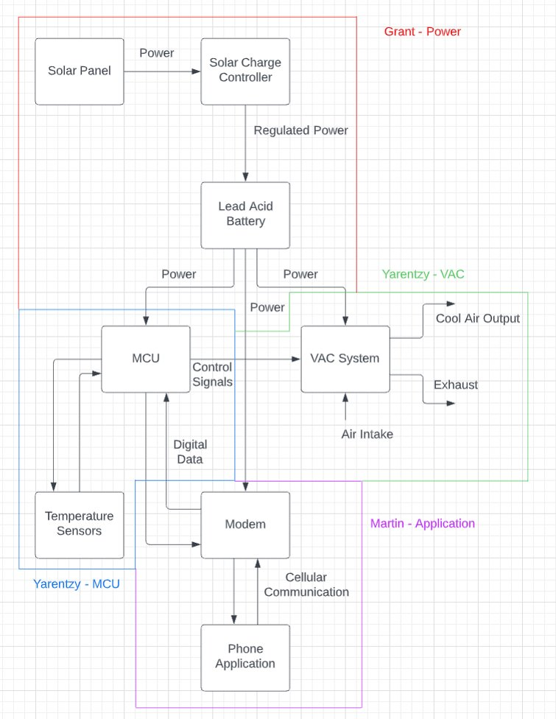
Project/Subsystem Overview

Slide 5
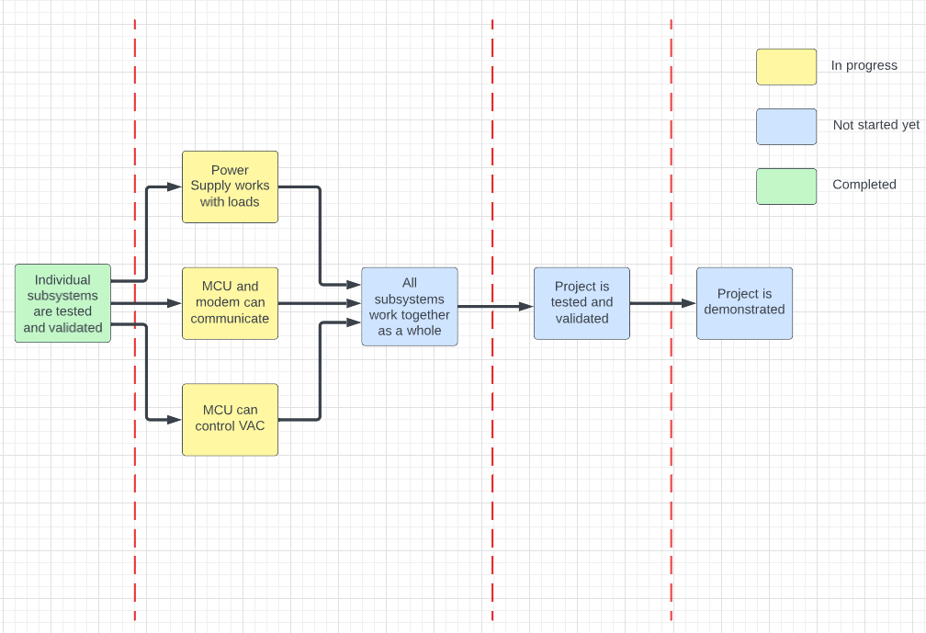
Project Timeline
8/28-9/23
9/24-10/28
10/29-11/30
12/1-12/2

Slide 6
Power Subsystem
Grant Franklin
Accomplishments since last presentation | Ongoing progress
Performed line/load regulation tests for both circuits on Perfboard Validated solar panel charging over a short period of time Ordered step-down components to power Servo motors | Take charging data over long period of time Test step-down components for Servo motors Finish designing and order final PCB with all parts for the stack Validate functionality of circuits with real loads and power supply input

Slide 7
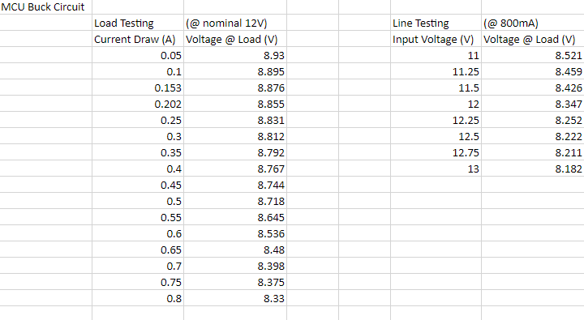
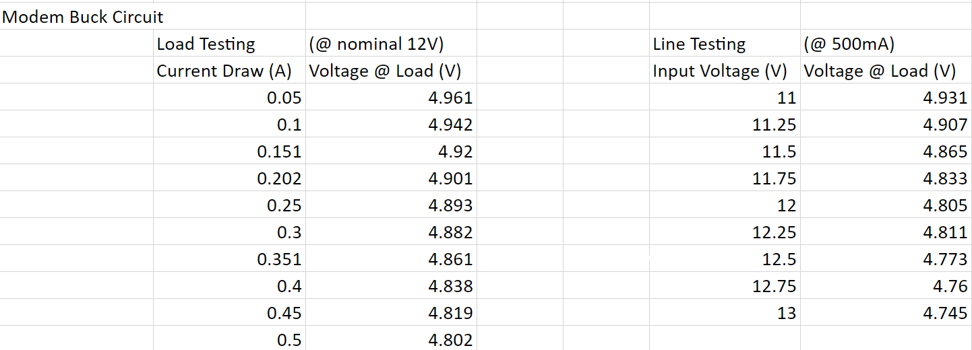
Power Subsystem
Grant Franklin
MCU Buck Circuit Line/Load Testing
Modem Buck Circuit Line/Load Testing

Slide 8
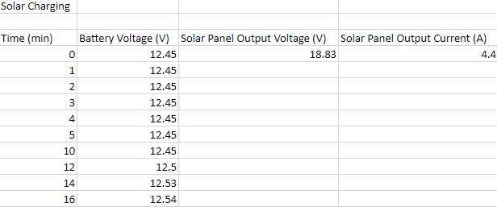
Power Subsystem
Grant Franklin
Sunny, 89°F day
9 min of bad data with faulty connection
Accurate data shows 0.015 V/min with good connection
Battery received 13.8V from the charge controller
Battery Solar Panel Charging (using a 17.9V, 100W panel)

Slide 9
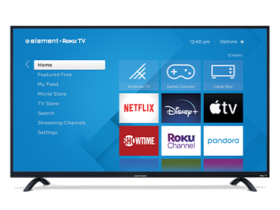
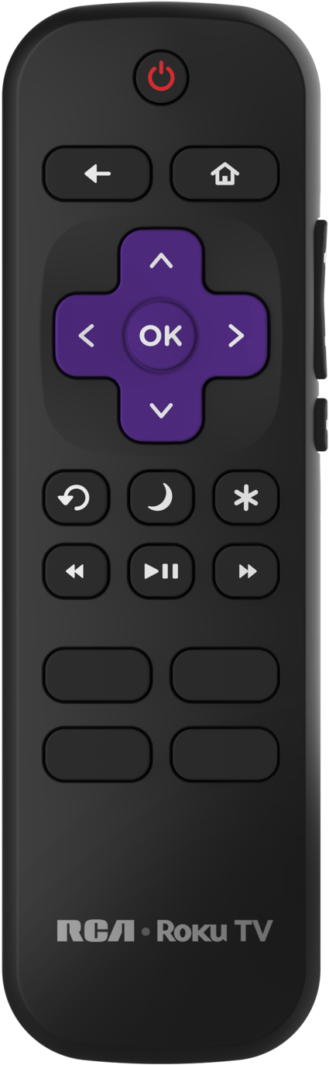
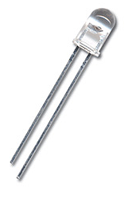
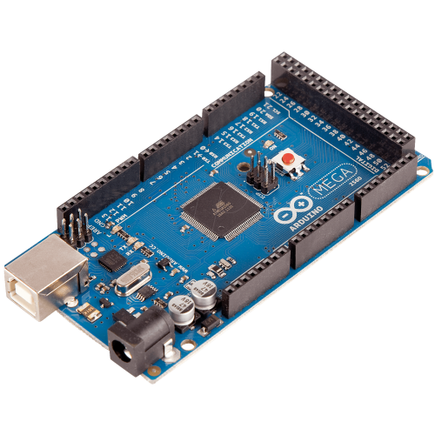
Integration with VAC
IR communication was established between MCU and Roku TV.
Gained full functionality of the remote
Notes:
Thank you Grant. Again my name is Yarentzy and I am in charge of the VAC and MCU subsystems. Since the last presentation I have sucessfully made my arduino into a roku remote. Using the IR library I decoded the NAC4 Roku protocol and gained full functionallity of my tv using my arduino. This was the idea for controlling the VAC unit. Decode the remote and mimic it using the Arduino however the VAC remote was not so plug and play

Slide 10
Integration with VAC
IR communication unsuccessful between MCU and VAC.
Remote protocol unknown with 3 different IR libraries
Called Media for technical support
Attempted to manually decode IR signal but obtained very inconsistent readings from detector
Notes:
The VAC remote had an unkown protocol. I contacted the VACs manufacturer and brand to gain more information on what kind of protocal it was using however I was either told that they could not share that information and that there was no one in thir technical department to provide support
I then attempted to manually decode the IR signals but obtained very inconsistant

Slide 11
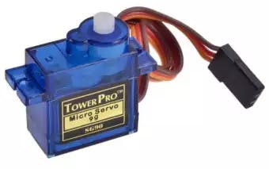
Integration with VAC
Transitioned to plan B: 3 servo motors "pressing down" on the buttons of the VAC
Servo motors obtained
Configured to rotate 180 degrees and back
Code in progress for user input

Slide 12
App and Modem
Martin Rennaker
Accomplishments since last presentation | Ongoing progress
Replaced SIM card Ordered new modem | Working on Serial communication between Modem and MCU

Slide 13
Modem Progress
Started with Waveshare made library
Made 2 custom iterations, one using SoftwareSerial and the other for default Serial configs
Tested each with both possible uart connections, no communication
Using Arduino as strictly an at command writer and reader
Still completely unable to connect
Ordered new modem

Slide 14
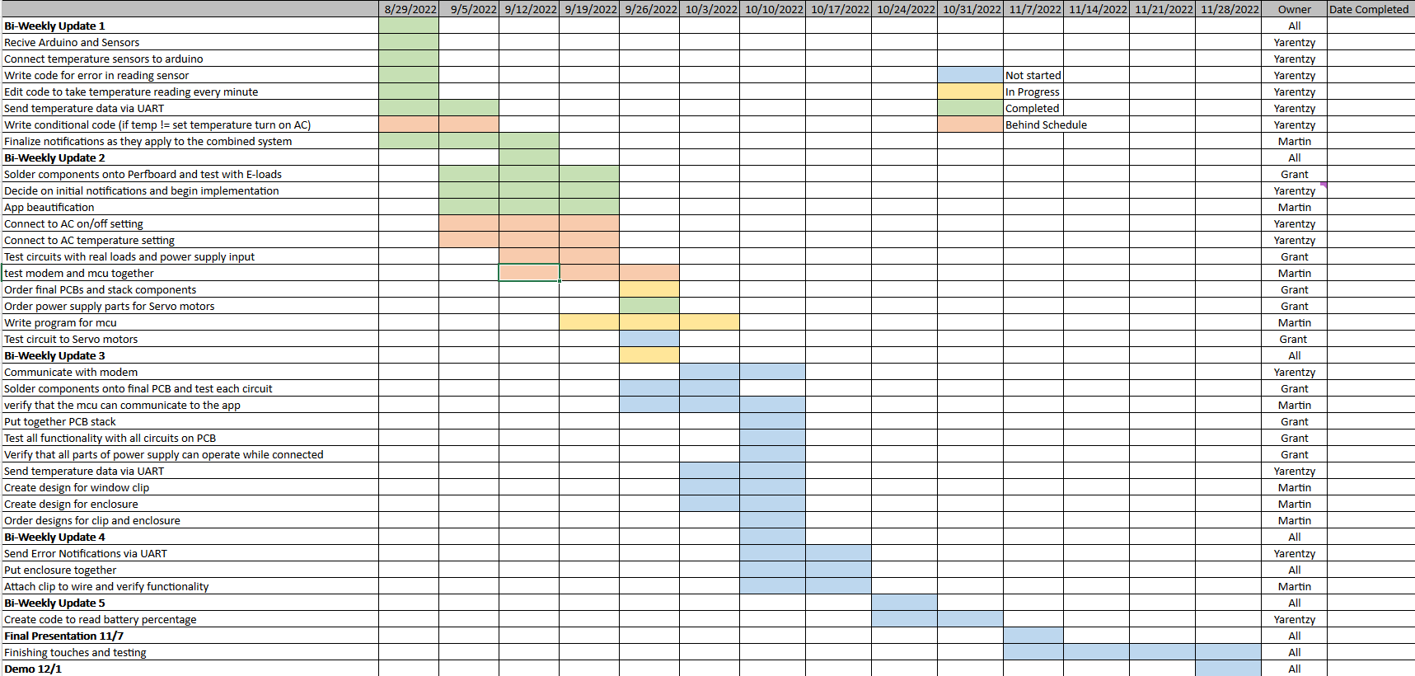
Execution Plan
Notes:
Michelle

Slide 15
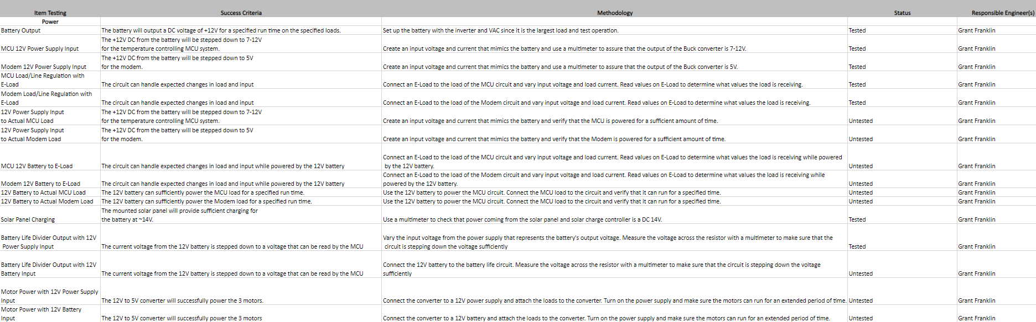
Validation Plan
Notes:
Michelle

Slide 16
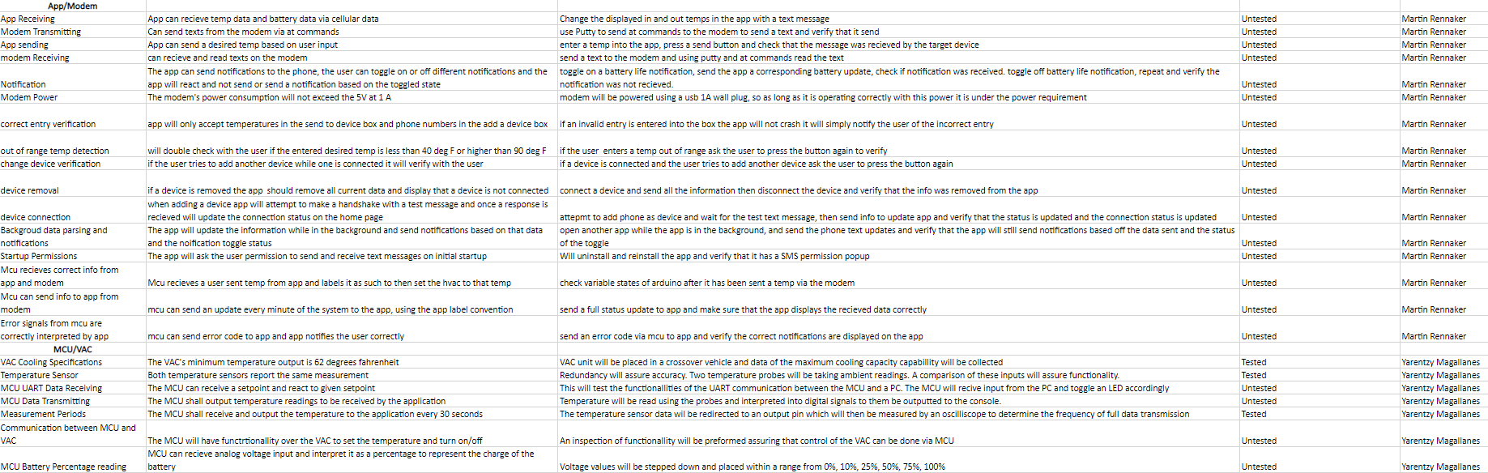
Validation Plan

Slide 17
Thank you!
Questions?

